Slide 1
System Analysis and Design CSI 311

Slide 2
SYSTEM
The term system is derived from the Greek work Systema, shows
An organized relationship among the functional units
Shows interrelation and Interdependence
Shows scope boundaries and mention exclusion areas
Shows purpose/ objectives/ goals of the system.

Slide 3
ORGANOGRAM
An organizational chart, or organogram, is a diagram that shows how an organization is structured, and how the positions in the organization are related to each other.
Three major types: Hierarchical, Matrix and Flat.

Slide 4
SDLC
SDLC
Concept
System Development Life Cycle

Slide 5
SDLC Phases 5/ 6/ 7
Idea Generation/Initial investigation/ Planning
Feasibility Study
Detail Study and Analysis
Design
Implementation/Construction (including testing)
Deployment
Post–Implementation & Maintenance
SDLC
Concept

Slide 6
SDLC Phase
1. Initial investigation
2. Feasibility Study
3. Analysis
4. Design
5. Implementation
6. Post–Implementation & Maintenance
SDLC
Concept

Slide 7
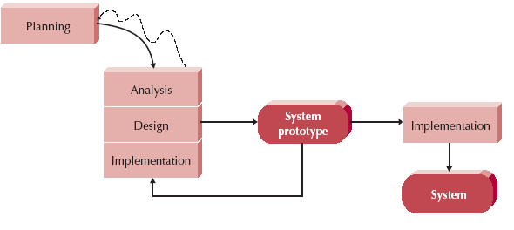
Prototyping SDLC
Implementation-→ Coding + Testing + Deployment

Slide 8
TYPES OF SYSTEM
ERP
DSS
ES
MIS
CRM
SCM
Social Networking
E-Commerce

Slide 9
1. INITIAL INVESTIGATION
It’s all about Information Gathering

Slide 10
1. Initial Investigation
Take the proposal from client.
Identify the problem.
Get information about the problem.
Get information from existing solution.
Problem definition and project initiation.
SDLC
Concept

Slide 11
1. Initial Investigation
The main objective of Initial investigation is collecting the information to build a system.
To complete the initial investigation most important process is Information Gathering.
SDLC
Concept

Slide 12
Information Gathering

Slide 13
Information: Information is the knowledge about the whole system.
Information Types:
There are three kinds of :
a) About Organization,
b) About User Staff,
c) About the Work Itself.
InformationGathering Concept

Slide 14
Information Type:
Information Gathering Concept
a) About Organization
> Mission, Vision, Policies
> Goals
> Organizational Structure

Slide 15
Information Type:
InformationGathering Concept
b) User Staff
>Authority Relationship
>Job Function
>Information Requirements
>Interpersonal Relationships

Slide 16
Information Types:
InformationGathering Concept
c) The work itself
>Work flow
>Methods and Procedure
>Work Schedule

Slide 17
1. Information Gathering
Sources of Information:
Newspapers & professional Journals
Personal Staff
Professional Staff
System Documentation
The User
Reports and Transaction Document
Vendors/ Suppliers
Government Documents
InformationGathering Concept

Slide 18
1. Information Gathering
Information gathering Tools:
Review Literature, Procedure & forms
On-site Observation
Interview
Questionnaires
Internet
JAD (Joint Application Development)
InformationGathering Concept

Slide 19

1. Information Gathering
Internet
You can search any kind of information over the internet.
InformationGathering Concept

Slide 20
1. Information Gathering
Review Literature, Procedure & forms
First step of information gathering.
Going through manuals, textbook, company study, government publication about that system.
We will be able to find a general standard for the system.
InformationGathering Concept

Slide 21
1. Information Gathering
Review Literature, Procedure & forms
Merits :
Manuals and forms are very useful sources
Up to date manuals saves hours of information gathering time.
Reviewing manuals it can be determined that what is the basic system requirements.
Printed forms are very useful to make input analysis.
InformationGathering Concept

Slide 22
1. Information Gathering
Review Literature, Procedure & forms
Demerits :
Sometimes the manual is out dated, or do not represent the exact current system .
All the information a system analyst need can not be full filled by this procedure. There would be some extra information needed to analysis the system correctly.
InformationGathering Concept

Slide 23
1. Information Gathering
On Site Observation :
It is the process of recognizing and noting people, objects and occurrences to obtain information.
The analyst plays the role of an observer followed by some rules to get the information how the real system works.
Example, for a Customer management system an analyst may act like a customer to gather information.
InformationGathering Concept

Slide 24
1. Information Gathering
On Site Observation :
Merits:
With this method system analysis is real time.
With Obtrusive observation some bugs of the system can be determine and therefore, removed.
InformationGathering Concept

Slide 25
1. Information Gathering
On Site Observation :
Demerits:
Adequate Training for the analyst is required in this method.
Attitudes and motivations of the subject cannot be readily observed.
There may be some error due to analyst.
It is time consuming
InformationGathering Concept

Slide 26
1. Information Gathering
Interview:
Interviews is the face to face interpersonal role situation to gather information by asking designated person questions.
It is like this, asking the person who is using the system or managing the system how they are managing.
InformationGathering Concept

Slide 27
1. Information Gathering
Interview:
Interviews is the face to face interpersonal role situation to gather information by asking designated person questions.
It is like this, asking the person who is using the system or managing the system how they are managing.
InformationGathering Concept

Slide 28
1. Information Gathering
Interview (Merits):
Interviewing the rightful person for the analyzing the system is a very fast process.
An effective technique for eliciting information about the complex subjects.
Its flexibility makes the interview a superior technique for exploring areas where not much is known.
InformationGathering Concept

Slide 29
1. Information Gathering
Interview (Demerits):
Long preparation time.
Interview takes long time to conduct.
Several time interview with the several persons which take more money and time.
InformationGathering Concept

Slide 30
1. Information Gathering
Interview (Procedure):
Select Interviewees
End users
Learn about individual prior to the interview
Prepare for the Interview
An interview guide is a checklist of specific questions the interviewer will ask the interviewee.
Conduct the Interview
Summarize the problem
Offer an incentive for participation
Ask the interviewee for assistance
Follow Up on the Interview
Memo that summarizes the interview
InformationGathering Concept

Slide 31
1. Information Gathering
Interview (Guideline):
Set the stage for the interview
Establish report, put the interviewee at ease
Phrase questions clearly and succinctly
Be a good listener
Evaluate the outcome of the interview
Use clear and concise language.
Don’t include your opinion as part of the question.
Avoid long or complex questions.
Avoid threatening questions.
Don’t use “you” when you mean a group of people.
InformationGathering Concept

Slide 32
1. Information Gathering
Interview (Questions):
Set the stage for the interview
Establish report, put the interviewee at ease
Phrase questions clearly and succinctly
Be a good listener
Evaluate the outcome of the interview
InformationGathering Concept

Slide 33
1. Information Gathering
Interview : To Do
InformationGathering Concept
Be courteous
Listen carefully
Maintain control
Probe
Observe mannerisms and nonverbal communication
Be patient
Keep interviewee at ease
Maintain self-control

Slide 34
1. Information Gathering
Interview : Not to Do
InformationGathering Concept
Continuing an interview unnecessarily.
Assuming an answer is
finished or leading nowhere.
Revealing verbal and nonverbal clues.
Using jargon
Revealing your personal biases.
Talking instead of listening.
Assuming anything about the topic and the interviewee.
Tape recording -- a sign of poor listening skills.

Slide 35
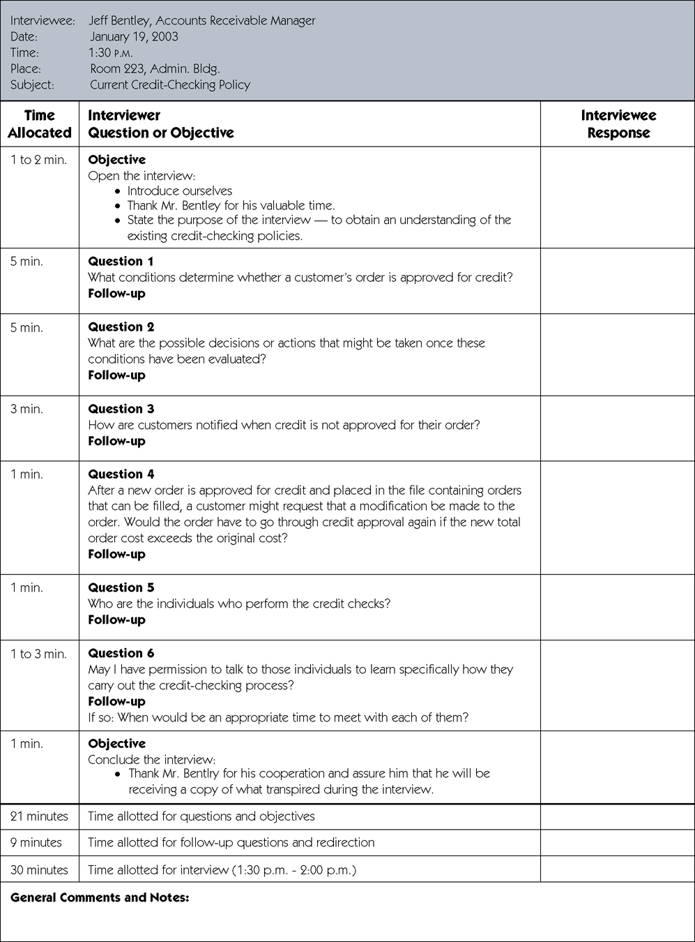
1. Information Gathering
Interview (sample guide):
InformationGathering Concept

Slide 36
1. Information Gathering
Interview (sample guide):
InformationGathering Concept

Slide 37
1. Information Gathering
Interview (Questions):
InformationGathering Concept
Types of Questions To Avoid
> Loaded questions
> Leading questions
> Biased questions

Slide 38
1. Information Gathering
Questionnaires:
Questionnaires are the tool that has questions to which any individual responds.
Example, A sheet of paper that has 50 standard question about how he is using the system may be defined as Questionnaires.
InformationGathering Concept

Slide 39
1. Information Gathering
Questionnaires: Merits:
Economical & requires less skill to administer.
Examines a large number of respondents at the same time.
InformationGathering Concept

Slide 40
1. Information Gathering
Questionnaires: Demerits:
Low percentage of returns
Dislike writing
InformationGathering Concept

Slide 41
1. Information Gathering
Questionnaires (Format of qustions ):
InformationGathering Concept
Rank the following transactions according to the amount of time you spend
processing them. ___ % new customer orders ___ % order cancellations
___ % order modifications
___ % payments
The implementation of quality discounts would cause an
increase in customer orders.  Strongly agree  Agree
 No opinion
 Disagree  Strongly disagree
Is the current accounts receivable
report that you receive useful?  Yes  No

Slide 42
2. Feasibility Study
Economical, Technical and Behavioral study

Slide 43
Feasibility Study
To determine what the candidate system is to do by defining its expected performance.
A feasibility study is carried out to select the best system that meets performance requirements.
SDLC
Concept

Slide 44
Feasibility Study
Types of Feasibility
a) Economic Feasibility
b) Technical Feasibility
c) Behavioral Feasibility
SDLC
Concept

Slide 45
Feasibility Study
Economic/Financial Feasibility
Known as cost benefit analysis
To determine the benefits and savings
That are expected from a candidate system and compare them with costs.
SDLC
Concept

Slide 46
Feasibility Study
Technical Feasibility
It checks whether the existing computer system or technology supports the candidate system or not or up to what extent it supports
It basically centers around Technology, Hardware, Software etc.
SDLC
Concept

Slide 47
Feasibility Study
Behavioral Feasibility
An estimate should be made of how strong a reaction the user staff is likely to have towards the development of a computerized system.
It is common knowledge that computer installation have something to do with Turnover, Transfers and changes in employee Job Status.
Customer group’s behavior should be taken in consideration
SDLC
Concept

Slide 48
Feasibility Study
Feasibility Study Steps
1. Form a project team and appoint a project leader.
2. Prepare system flowcharts.
3. Enumerate potential candidate systems.
4. Describe and identify characteristics of candidate systems.
5. Determine and evaluate performance/ weighted performance and cost effectiveness of each candidate system.
6. Select the best candidate system.
7. Prepare and report final project directive to management.
SDLC
Concept

Slide 49
3. Analysis
Definition of approved requirements, Development of planned

Slide 50
3. Analysis
The Requirements Analysis Phase begins when the previous phases (planning, information gathering) objectives have been achieved.
Documentation related to user requirements from the Concept Development Phase and the Planning Phase shall be used as the basis for further user needs analysis .
Multiple-release projects require only one iteration of the Requirements Analysis Phase, which should involve requirements definition for all planned releases.
SDLC
Concept

Slide 51
3. Analysis
Objectives
Successful completion of the Requirements Analysis Phase should comprise:
• Definition of approved requirements.
• Development of planned test activities
• Approval to progress to the other phase.
• Creation of the System Requirements Document and Requirements Traceability Matrix
SDLC
Concept

Slide 52
3. Analysis
Main Goals
The purpose of the Requirements Analysis Phase is to transform the needs and
high-level requirements specified in earlier phases into unambiguous (measurable and testable), traceable, complete, consistent, and stakeholder-approved requirements.
SDLC
Concept

Slide 53
Design
SDLC
Concept

Slide 54
4. Design
In this phase of SDLC, software design is prepared from the requirement specifications
System Design helps in specifying system requirements and also helps in defining overall system architecture.
SDLC
Concept

Slide 55
4. UML Design version of UML: https://www.uml-diagrams.org/
Different diagrams are as follows:
Context Diagram.
Activity Diagram.
Use Case
Class Diagram
CRC
Sequence Diagram
State Diagram.
Deployment Diagram
SDLC
Concept
Data Flow Diagram.
Decision Tree
Decision Tables
Structured English
Data Dictionary

Slide 56
Context Diagram
The Context Diagram shows the system under consideration as a single high-level process.

Slide 57
Context Diagram
4. Design
Definition:
SDLC
Concept
It shows the system under consideration as a single high-level process and shows the relationship that the system has with other external entities.
i.e. systems, organizational groups, external data stores, etc.

Slide 58
Context Diagram
4. Design
Definition:
SDLC
Concept
Top-level view
A single process
Contain Main data flows
Interfaces between the system and the outside terminators.
No internal data stores are shown

Slide 59
Context Diagram
4. Design
Context Diagram of Order System:
SDLC
Concept

Slide 60
Data Flow Diagram

Slide 61
4. Design
DFD
A Data-Flow Diagram (DFD) is a graphical visualization of the movement of data through an information system.
DFDs are one of the Structured systems analysis and design method (SSADM).
A DFD is process centric and depicts 4 main components.
Processes (circle)
External Entities (rectangle)
Data Stores (two horizontal parallel lines wither both side or one side open ended)
Data Flows (line with arrowhead indicating flow direction)
SDLC
Concept

Slide 62
4. Design
DFD
Benefits of DFD
Easier to understand.
Make design phase more easier.
Process of the whole system can be determined easily.
Easier to construct.
SDLC
Concept

Slide 63
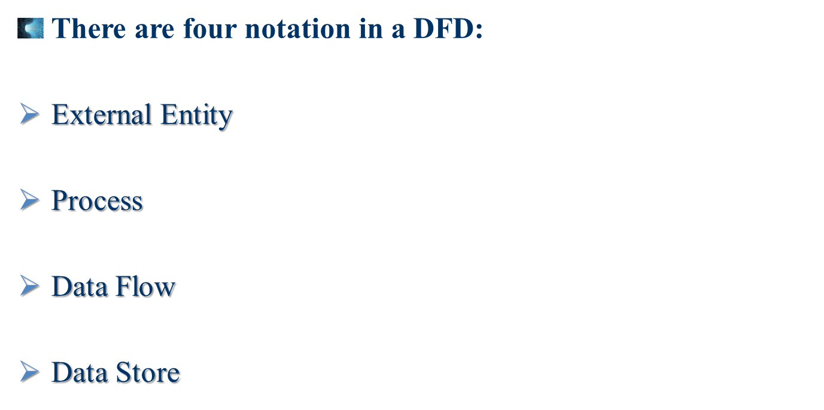
4. Design
DFD
SDLC
Concept
Data store

Slide 64
DFD
4. Design
Components description:
SDLC
Concept
Process :
An activity or function performed for a specific business reason.
Manual or computerized.
Processes

Slide 65
DFD
4. Design
Components description:
SDLC
Concept
Data flow :
A single piece of data or a logical collection of data
Always starts or ends at a process

Slide 66
DFD
4. Design
Components description:
SDLC
Concept
Data Store :
A collection of data that is stored in some way
Data flowing out is retrieved from the data store
Data flowing in updates or is added to the data store
Data store
OR

Slide 67
DFD
4. Design
Components description:
SDLC
Concept
External entities
External entity :
A person, organization, or system that is external to the system but interacts with it.

Slide 68
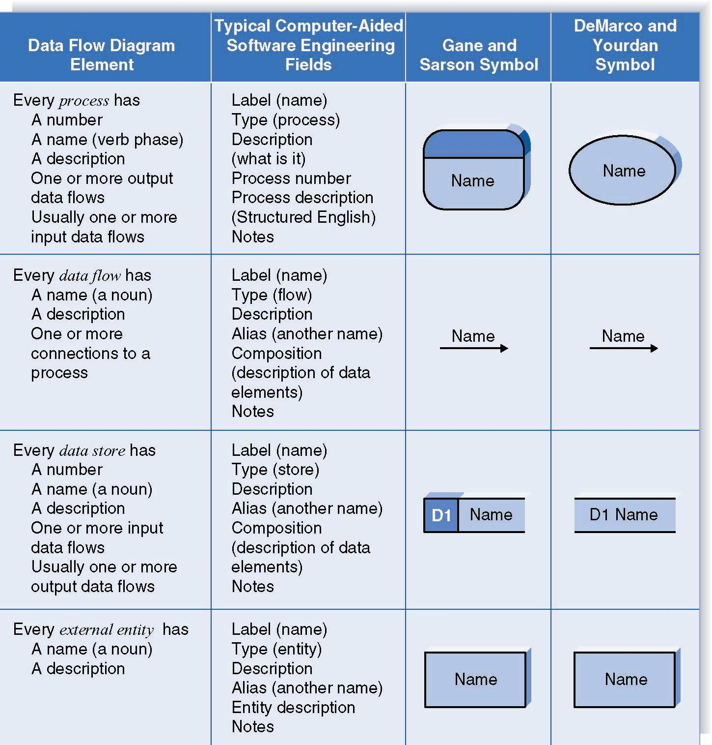
DFD
4. Design
Components description:
SDLC
Concept
Process
Data flow
Data store
External
entity

Slide 69
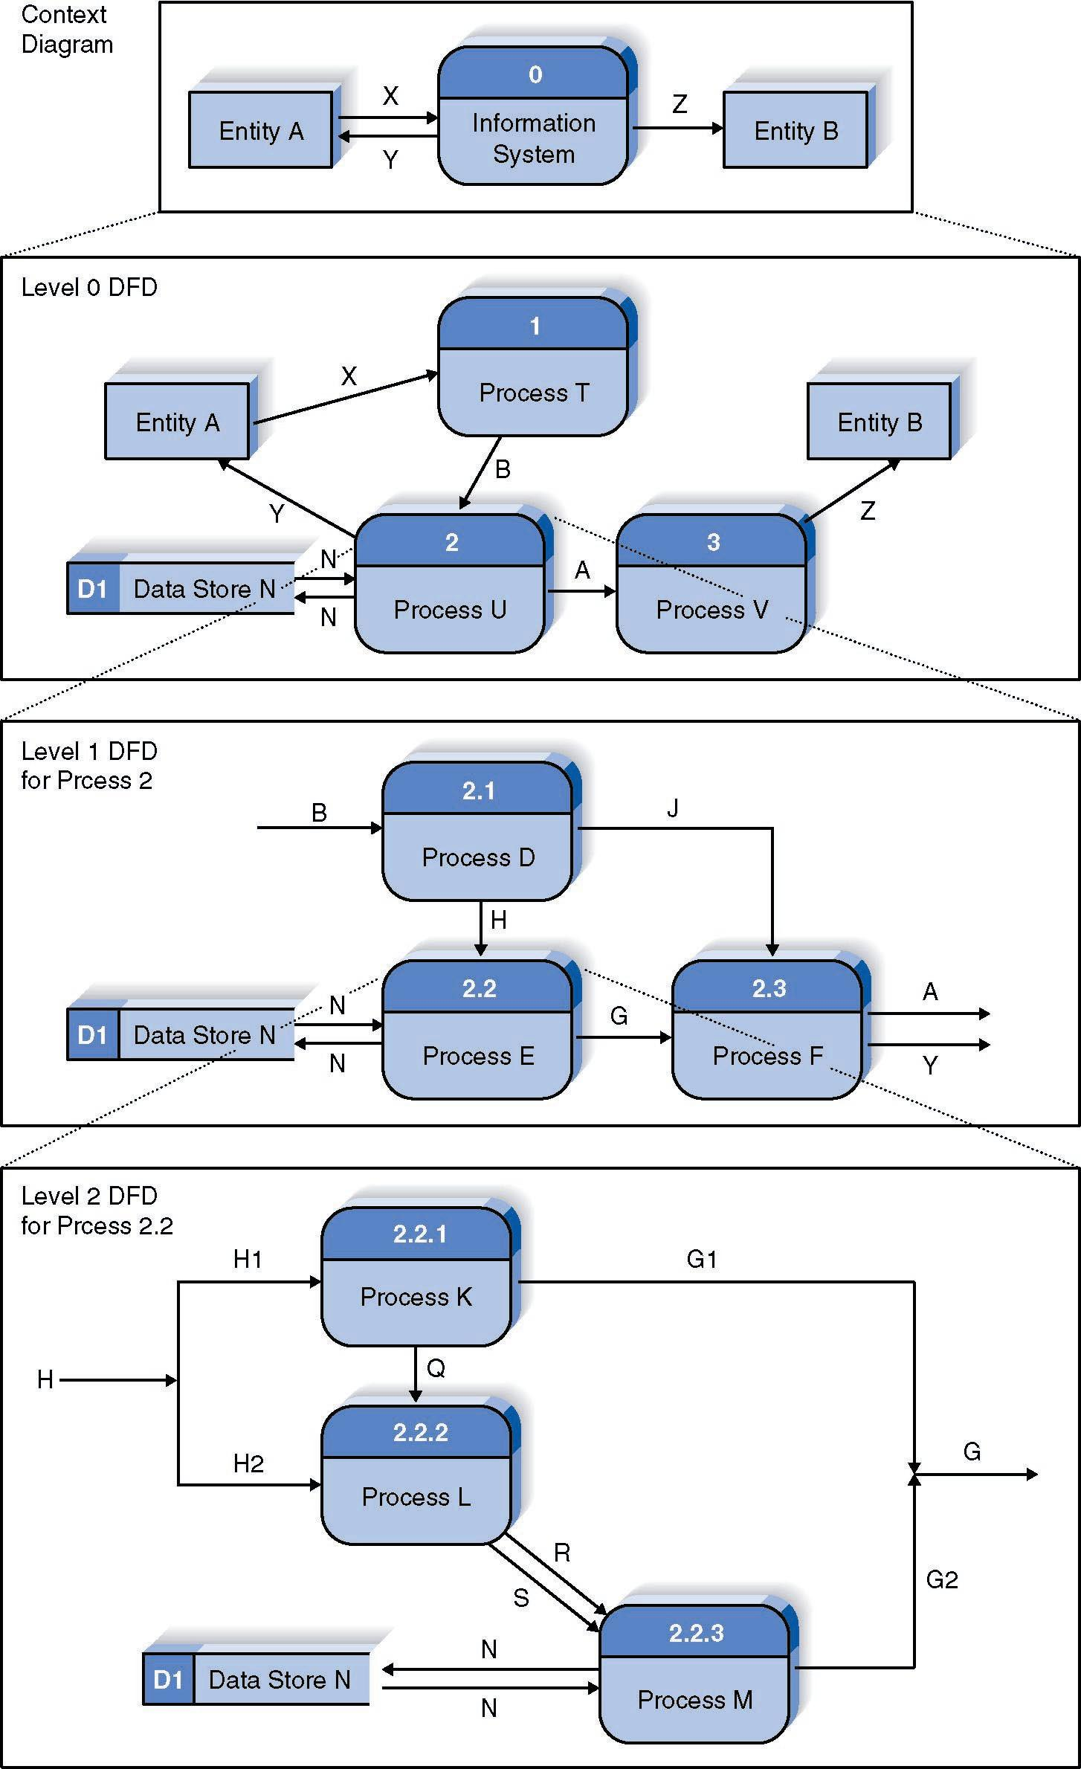
DFD
4. Design
Context diagram
SDLC
Concept
Level 0 diagram
Level 1 diagram
Level 2 diagram

Slide 70
DFD
4. Design
Level 0 Diagram :
SDLC
Concept
Shows all the major processes that comprise the overall system – the internal components of process 0
Shows how the major processes are interrelated by data flows
Shows external entities and the major processes with which they interact
Adds data stores

Slide 71
DFD
4. Design
Level 1 Diagram :
SDLC
Concept
Generally, one level 1 diagram is created for every major process on the level 0 diagram
Shows all the internal processes that comprise a single process on the level 0 diagram
Shows how information moves from and to each of these processes
If a parent process is decomposed into, for example, three child processes, these three child processes wholly and completely make up the parent process

Slide 72
DFD
4. Design
Level 2 Diagram :
SDLC
Concept
Shows all processes that comprise a single process on the level 1 diagram
Shows how information moves from and to each of these processes
Level 2 diagrams may not be needed for all level 1 processes
Correctly numbering each process helps the user understand where the process fits into the overall system

Slide 73
DFD
4. Design
Summary :
SDLC
Concept
The Data Flow Diagram (DFD) is an essential tool for creating formal descriptions of business processes.
Use cases record the input, transformation, and output of business processes and are the basis for process models.
Eliciting use cases and modeling business processes are critically important skills for the systems analyst to master.

Slide 74
Activity Diagram
Represent the business and operational workflow of a system.

Slide 75
Activity Diagram Activity Diagram
4. Design
Definition:
SDLC
Concept
Represent the business and operational workflow of a system
Shows activity, and event that causes object to be in particular state

Slide 76



Activity Diagram Activity Diagram
4. Design
Symbols:
SDLC
Concept
Starting point
First activity of the flow
Activity
Decisions

Slide 77

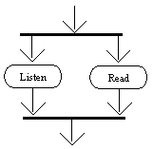

Activity Diagram Activity Diagram
4. Design
Symbols:
SDLC
Concept
Signals (input and output)
Concurrent activity
Final activity

Slide 78
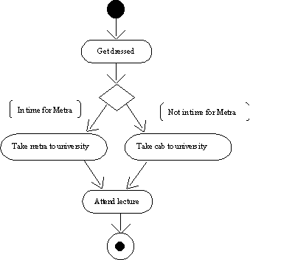
Activity Diagram Activity Diagram
4. Design
Example:
SDLC
Concept

Slide 79
Use Case
Describe what a system does rather than how.

Slide 80
4. Design
Use Case Diagram use Case Diagram
Use case diagrams describe what a system does from the standpoint of an external observer.
Describe what a system does rather than how.
Use case diagrams are closely connected to scenarios. A scenario is an example of what happens when someone interacts with the system.
Here we will describe a scenario for a Diagnostic Center.
SDLC
Concept

Slide 81
Use Case Discription
What a system does.

Slide 82
4. Design
Use Case Diagram use Case Diagram
A use case diagram is a collection of actors, use cases, and their communications.
We've put an actor as part of a diagram with four actors will be four use cases.
Notice that a single use case can have multiple actors.
SDLC
Concept

Slide 83
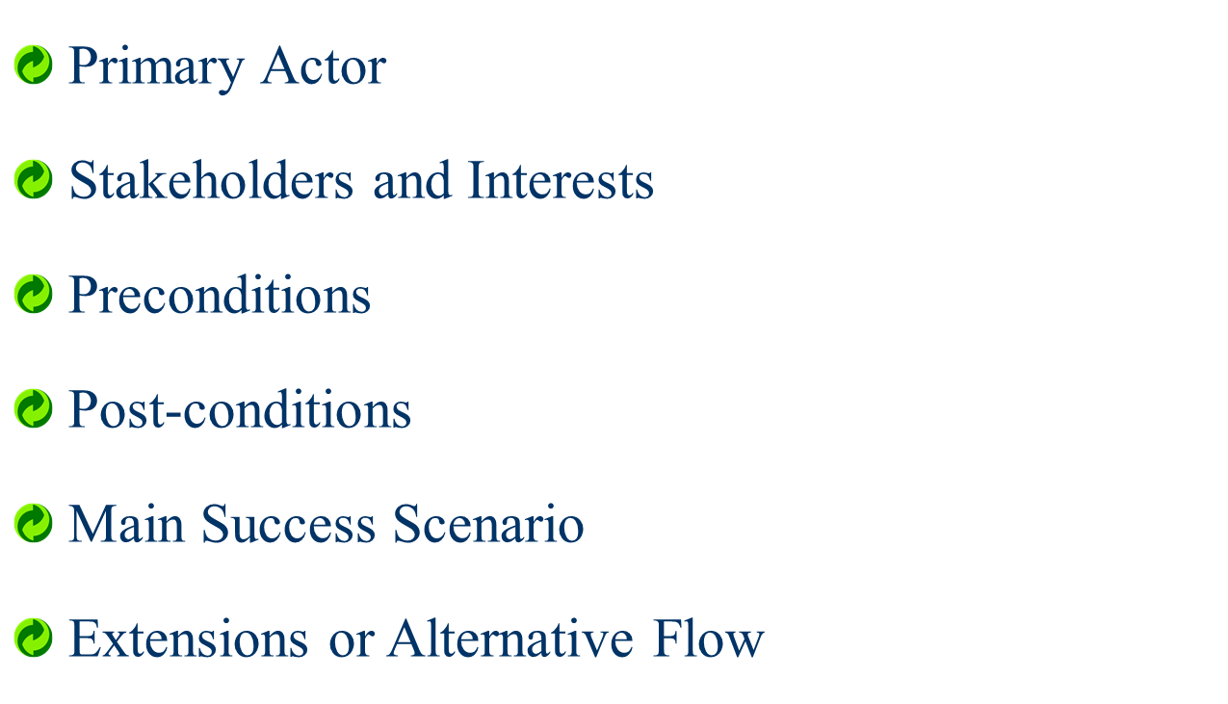
4. Design
Use Case Diagram use Case Diagram
SDLC
Concept

Slide 84
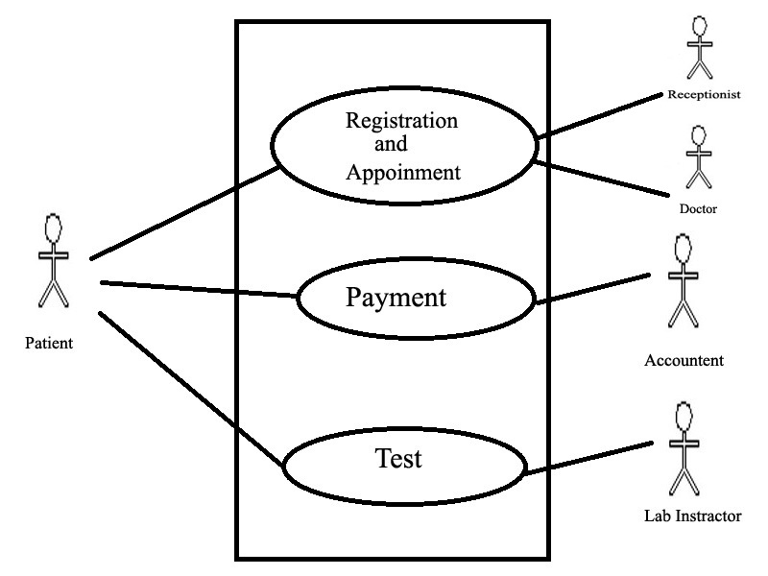
USE CASE Diagram of Diagnostic Management System

Slide 85

4. Design
Use Case Diagram use Case Diagram
Use Case 01: Registration and Appointment
Primary Actor : Receptionist
Stakeholders and Interests :
-Patient : Patient is the main person who want make a consultation with doctor
-Receptionist : Receptionist give the support and provide information to the patient .
-Doctor : Doctor is a key who make his/her own schedule for the appointment.
SDLC
Concept

Slide 86
4. Design
Use Case Diagram use Case Diagram
Preconditions :
-Patient have to complete the registration.
Post-conditions :
- Schedule and doctor will be Matched.
- Patient information is saved.
SDLC
Concept

Slide 87
4. Design
Use Case Diagram use Case Diagram
SDLC
Concept
Main Success Scenario :
-1.Patient arrives at the diagnostic center, collect the information from receptionist
-2. Complete the registration from receptionist
-3. Check the time schedule and take an appointment for doctor
-4.Doctor give the treatment as test and prescription.

Slide 88
4. Design
Use Case Diagram use Case Diagram
Extensions or Alternative Flow
- for 3
You must have to Registered one- Before taking schedule ensure
If patient not interested to complete the test in our diagnostic center
Doctor confirmed.
- only for consultation
- next consultation date.
SDLC
Concept

Slide 89
4. Design
Use Case Diagram use Case Diagram
Extensions or Alternative Flow :
- Before taking schedule ensure
If patient interested to complete the test in our diagnostic center.
Also not appointed to this diagnostic centers doctor
receptionist confirmed :
- only for test
- report delivered date.
SDLC
Concept

Slide 90
4. Design
Use Case Diagram use Case Diagram
Extensions or Alternative Flow :
- Before taking schedule ensure
If patient interested to complete the test in our diagnostic center
Also appointed to this diagnostic centers doctor
receptionist confirmed.
- Our Patient (consultation and test)
- report delivered date.
SDLC
Concept

Slide 91
4. Design
Use Case Diagram use Case Diagram
Use Case 02: Payment
Primary Actor : Accountant
Stakeholders and Interests :
-Patient : who want to complete the payment
-Accountant : Accountant is received the money from patient.
-Government : Collected the tax.
-Diagnostic center: Collected the revenue.
SDLC
Concept

Slide 92
4. Design
Use Case Diagram use Case Diagram
Preconditions : Patient have to complete the registration and make an appointment for doctor or test
Post-conditions :
- Calculate the cost for test or appointment.
- Patient information is saved.
- Government tax will be calculated.
- Revenue of the organization will be calculated
SDLC
Concept

Slide 93
4. Design
Use Case Diagram use Case Diagram
Main Success Scenario :
-1.Patient go to Accountant
-2. Accountant calculated the cost of each test or appointment
-3. Collect he money from patient.
-4. Accountant complete the database from.
SDLC
Concept

Slide 94
4. Design
Use Case Diagram use Case Diagram
Extensions or Alternative Flow :
- for 3
You must have no money then we can not make service for you.
- Before Collecting money ensure
If patient not interested to complete the test in our diagnostic center
Doctor confirmed.
- only for consultation
- next consultation date.
SDLC
Concept

Slide 95
4. Design
Use Case Diagram use Case Diagram
Extensions or Alternative Flow :
- Before Collecting money ensure
If patient interested to complete the test in our diagnostic center
Also not appointed to this diagnostic centers doctor
receptionist confirmed.
- only for test
- report delivered date.
SDLC
Concept

Slide 96
4. Design
Use Case Diagram use Case Diagram
Use Case 03: Test
Primary Actor : Lab Instructor
Stakeholders and Interests :
-Patient : who want to complete the test
-Lab Instructor: Instructor complete the lab test and provide the lab report
- Doctor: Will see the reports from instructor and sign it
or revise it.
SDLC
Concept

Slide 97
4. Design
Use Case Diagram use Case Diagram
Preconditions : Patient have to complete the payment.
Post-conditions :
- Patient information is saved.
- Report delivery date confirmed
SDLC
Concept

Slide 98
4. Design
Use Case Diagram use Case Diagram
Main Success Scenario :
-1.Patient arrive to the Lab Instructor.
-2. Instructor check the payment is clear or no.
-3. Complete the test.
-4. Give the report delivery date .
SDLC
Concept

Slide 99
4. Design
Use Case Diagram use Case Diagram
Extensions or Alternative Flow :
- for complete the test
You must have no money then we can not make service for you.
SDLC
Concept

Slide 100
State Diagram
State Machine diagram can show the different states of an entity.

Slide 101
State Diagram State Diagram
4. Design
Definition:
SDLC
Concept
The behavior of an entity is not only a direct consequence of its input, but it also depends on its preceding state.
The history of an entity can best be modeled by a finite state diagram.
State Machine diagram can show the different states of an entity also how an entity responds to various events by changing from one state to another.

Slide 102
State Diagram State Diagram
4. Design
Symbols:
SDLC
Concept
Starting point
State
Work of duration [working process]

Slide 103
State Diagram State Diagram
4. Design
Symbols:
SDLC
Concept
Signals (input and output)
condition
Final activity

Slide 104
State Diagram State Diagram
4. Design
Registration process of UIU:
SDLC
Concept
[Do to pre registration]
[pay to the accountant for registration]
[Do final registration]
End
Starting
Pre_reg
Pament
complete
Final_reg
complete

Slide 105
Class Diagram
The class diagram represents the static view of an application.

Slide 106
Class Diagram ClassDiagram
4. Design
Definition:
SDLC
Concept
The class diagram is a static diagram. It represents the static view of an application.
The class diagram describes the attributes and operations of a class and also the constraints imposed on the system.
It shows a collection of classes, interfaces, associations, collaborations and constraints.

Slide 107
Class Diagram ClassDiagram
4. Design
Definition:
SDLC
Concept
Class Diagram provides an overview of the target system by describing the objects and classes inside the system and the relationships between them.
It provides a wide variety of usages; from modeling the domain-specific data structure to detailed design of the target system.
With the share model facilities, you can reuse your class model in the interaction diagram for modeling the detailed design of the dynamic behavior.

Slide 108
Class Diagram ClassDiagram
4. Design
Purpose of Class Diagram:
SDLC
Concept
Analysis and design of the static view of an application.
Describe responsibilities of a system.
Base for component and deployment diagrams.
Forward and reverse engineering.

Slide 109
4. Design
4. Design
Class Diagram ClassDiagram
Relationship and Symbols:
SDLC
Concept
There are four diffrent relationship and symbols :
Multiplicity
Association / Aggregation
Composition
Inharitance

Slide 110
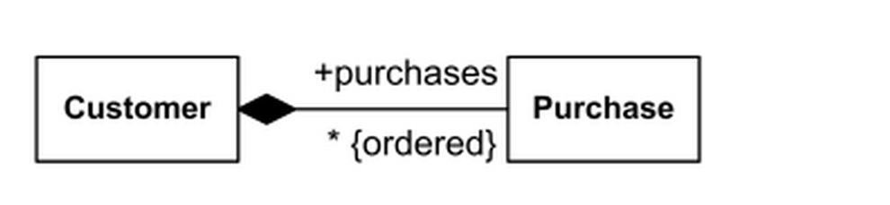
Class Diagram ClassDiagram
4. Design
Multiplicity:
SDLC
Concept
Multiplicity is a definition of (number of elements ) of some collection of elements.

Slide 111
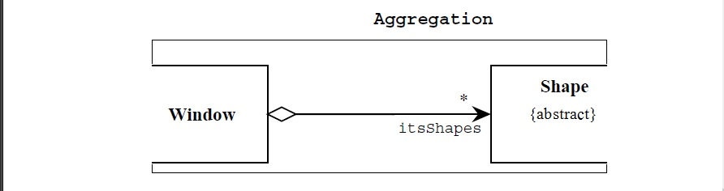
Class Diagram ClassDiagram
4. Design
Associative/Aggregation :
SDLC
Concept
The weak form of aggregation is denoted with an open diamond.
This relationship denotes that the aggregate class is in some way the “whole”, and the other class in the relationship is somehow “part” of that whole.

Slide 112
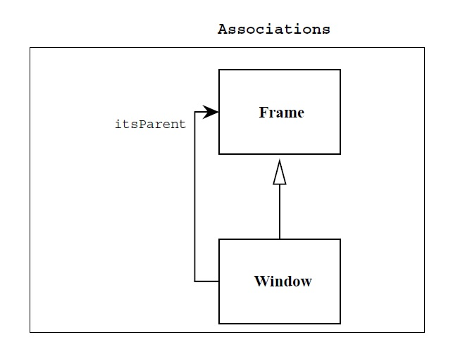
4. Design
Associative/Aggregation :
SDLC
Concept
Associations do not denotes whole/part relationships whereas aggregation does.

Slide 113
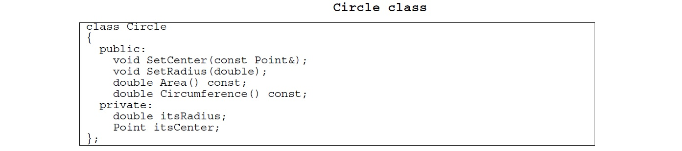

Class Diagram ClassDiagram
4. Design
Composition :
SDLC
Concept
Each instance of type Circle seems to contain an instance of type Point. This is a relationship known as composition.

Slide 114
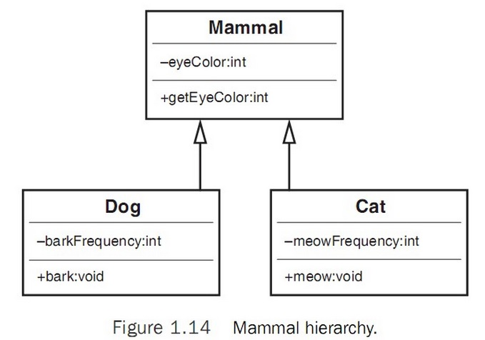
Class Diagram ClassDiagram
4. Design
Inheritance:
SDLC
Concept

Slide 115
To be continue

